Slide 1

Implementation of Chatbot using Tensorflow, Natural Language Processing
Topic : HUMAN COMPUTER INTERACTION

Slide 2
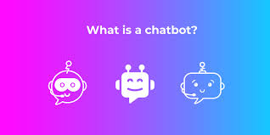

Slide 3
INTRODUCTION
A chatbot is a computer program that simulates and processes human conversation (whether written or spoken), allowing humans to interact with digital devices as if they were talking to a real person. Chatbots can range from simple programs that respond to a single-line query to sophisticated digital assistants that learn and evolve to provide increasing levels of personalization as they gather and process data.

Slide 4
History of Chatbot
Eliza was the very first chatbot as mentioned above. It was created by Joseph Weizenbaum in 1966 and it uses pattern matching and substitution methodology to simulate conversation.
The program was designed in a way that it mimics human conversation. The Chatbot ELIZA worked by passing the words that users entered into a computer and then pairing them to a list of possible scripted responses.

Slide 5
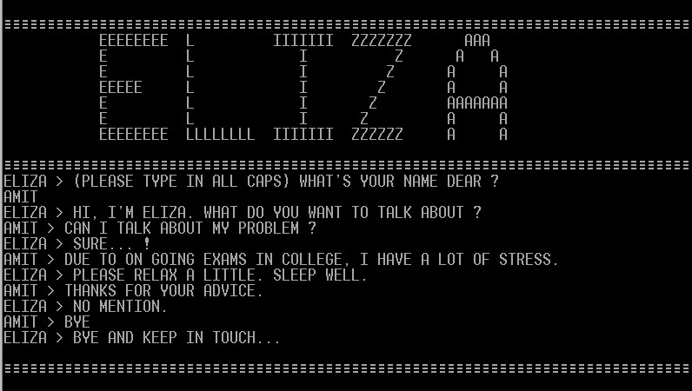

Slide 6
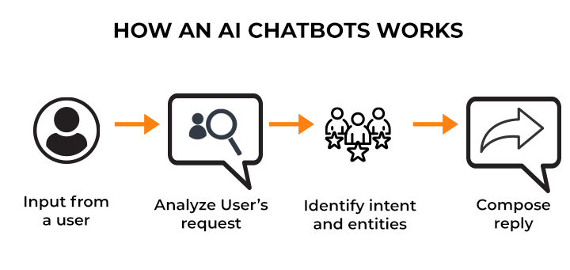

Slide 7
Natural Language Processing
Natural Language Processing is abbreviated as NLP. You can assist a machine in understanding human speech and spoken words by using NLP technology. NLP combines rule-based modeling of human spoken language with intelligent algorithms such as statistical, machine, and deep learning algorithms. These technologies work together to create the intelligent voice assistants and chatbots that you may encounter in your daily life.

Slide 8
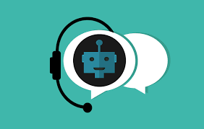
There are a number of human errors, differences, and special intonations that humans use every day in their speech. NLP technology allows the machine to understand, process, and respond to large volumes of text rapidly in real-time.
In everyday life, you have encountered NLP tech in
voice-guided GPS apps
virtual assistants
speech-to-text note creation apps
support chatbots

Slide 9
Identifying Intents and Entities
intent refers to the goal the customer has in mind when typing in a question or comment, entity refers to the modifier – fields, data, or text, the customer uses to describe their requirement while the intent is what they really mean. Let’s understand this through an example.
Intents and entities are the building blocks of natural language understanding by context.

Slide 10
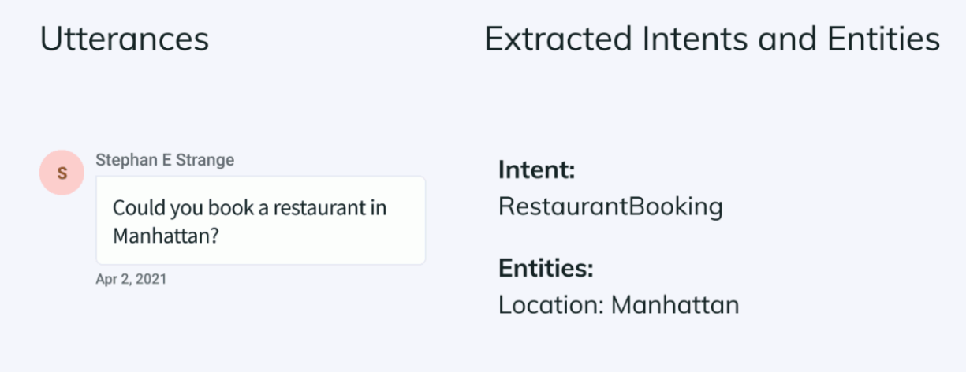

Slide 11
Tokenization
Tokenization is breaking the raw text into small chunks. Tokenization breaks the raw text into words, sentences called tokens. These tokens help in understanding the context or developing the model for the NLP. The tokenization helps in interpreting the meaning of the text by analyzing the sequence of the words.
For example, the text “It is raining” can be tokenized into ‘It’, ‘is’, ‘raining’

Slide 12
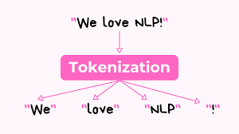

Slide 13
Stemming
Stemming is the process of producing morphological variants of a root/base word. Stemming programs are commonly referred to as stemming algorithms or stemmers. A stemming algorithm reduces the words “chocolates”, “chocolatey”, “choco” to the root word, “chocolate” and “retrieval”, “retrieved”, “retrieves” reduce to the stem “retrieve”. Stemming is an important part of the pipelining process in Natural language processing

Slide 14
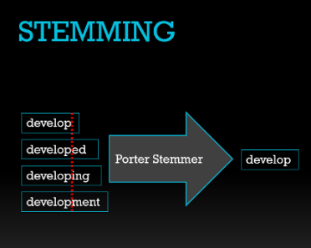

Slide 15
TFlearn is a modular and transparent deep learning library built on top of Tensorflow. It was designed to provide a higher-level API to TensorFlow in order to facilitate and speed-up experimentations, while remaining fully transparent and compatible with it.
TensorFlow is an end-to-end open source platform for machine learning. It has a comprehensive, flexible ecosystem of tools, libraries and community resources that lets researchers push the state-of-the-art in ML and developers easily build and deploy ML powered applications.

Slide 16
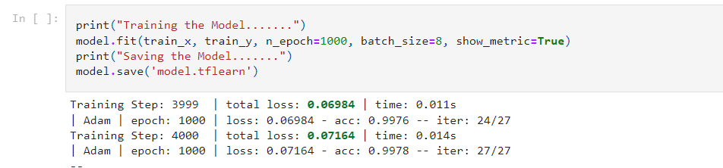
Training Model
Training a Deep Neural Network with the processed text Data

Slide 17
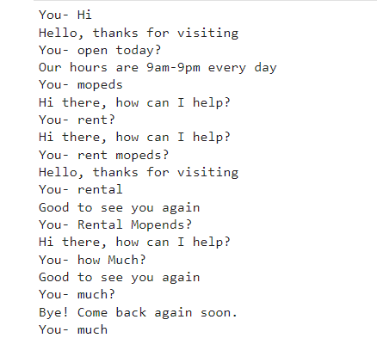
Final output

Slide 18
Conclusion
AI chatbots will never replace your customer service representatives. However, chatbots and customer service representatives can and will work together. For example, an AI chatbot can be used as an entry point for customers, identifying their issue and either helping them resolve it .or correctly routing it

Slide 19
References
Guendalina Caldarini, Sardar Jaf, Kenneth Mcgarry. A Literature Survey of Recent Advances in Chatbots. Information, MDPI, 2022, 13 (1), pp.41. ff10.3390/info13010041ff. ffhal-03528673f
Artificial Intelligence Applications and Innovations. 2020; 584: 373–383. Published online 2020 May 6. doi: 10.1007/978-3-030-49186-4_31
TensorFlow publishes a DOI for the open-source code base using Zenodo.org: 10.5281/zenodo.4724125
Bird, S., Klein, E., & Loper, E. (2009). Natural language processing with python. O’Reilly Media.

Slide 20
THANK YOU : )
- Shilpa Polepalli

